Slide 1
HL ONLY
TOPIC B4:
ABSTRACT DATA TYPES
LESSON B4-3
SETS

Slide 2

AGENDA
Sets
Creating Setsw
Set functions
Set operations
Union
Intersection
Difference
Subset
WHAT U NEED 4 LESSON
Pycharm
Notes Document

Slide 3

THE WARM UP QUESTION
Identify three characteristics of Linked Lists

Slide 4
THE WARM UP ANSWER
Ordered
Dynamic Length
Can be singly, doubly, or circular
Has nodes and pointers
Must be searched by traversing nodes by pointers
Typically implemented using objects

Slide 5

SETS
Sets, like lists/arrays, are used to store multiple values in a single variable
The key difference between sets and Python lists is that sets are unordered
This means that you cannot access them via index
It’s sort of like a giant sack of data
Sets may contain NO duplicate items
Ever
Ever
Like at all

Slide 6
SETS
Sets are mutable, meaning that data can be added/removed after the set has been created
This is similar to a list
Once data is added to a set, it cannot be modified
You can’t add more to a number once it’s added to a set

Slide 7

SETS
Sets are helpful when you want to make sure that a collection consists of only unique elements, such as websites where duplicate usernames are not allowed
Also very fast when checking if an item is in a collection
Algorithms tend to be very efficient on sets

Slide 8
CREATING SETS
Python has two ways of creating sets
Curly Brackets
Set Constructor
#making sets #using curly brackets my_set = {1,2,3,4,5} print(my_set) #using the set() constructor #duplicate entries will be automatically removed my_set2 = set([1,2,3,4,4,5]) print(my_set2)

Slide 9
CREATING SETS
What Python data structure does that top option look a lot like?
#making sets #using curly brackets my_set = {1,2,3,4,5} print(my_set) #using the set() constructor #duplicate entries will be automatically removed my_set2 = set([1,2,3,4,4,5]) print(my_set2)

Slide 10
SET FUNCTIONS
To add/remove from a set, use .add() for add, and .remove() for removing
Remember that we don’t have indexes here
We aren’t removing the item at index 1, we are removing the number 1
#add 6 to the set my_set.add(6) #remove 1 from the set my_set.remove(1)

Slide 11
SET FUNCTIONS
To check if elements are present in a set, we have to use an if statement
Unfortunately, there’s no way to directly get the True/False value of an element being in the set or not
#checking if an item is in a set if 2 in my_set: print("2 is in da set") else: print("2 is not in the set")

Slide 12
SET OPERATIONS
Sets have a handful of operations we can use to manipulate and compare sets
These are:
Union
Intersection
Difference

Slide 13

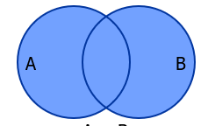
UNION
A union is a simple operation that joins two sets together
It contains all of the elements from both sets, without any duplicates

Slide 14
UNION
There are two ways to program unions
Using the bar operator
Using the .union function
A = {1, 2, 3, 4} B = {3, 4, 5 ,6} #creating a union using the bar union_set = A | B #creating a union using the function union_set = A.union(B)
print(union_set)

Slide 15
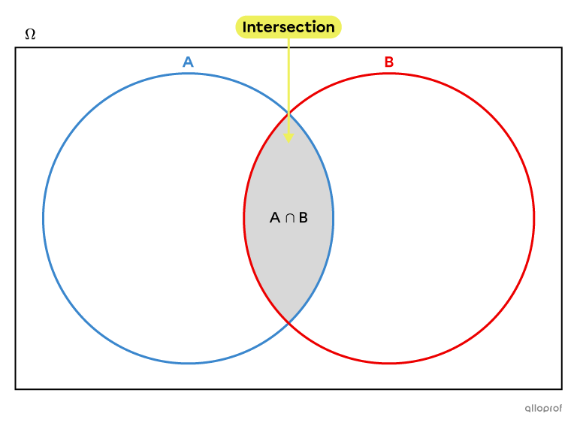
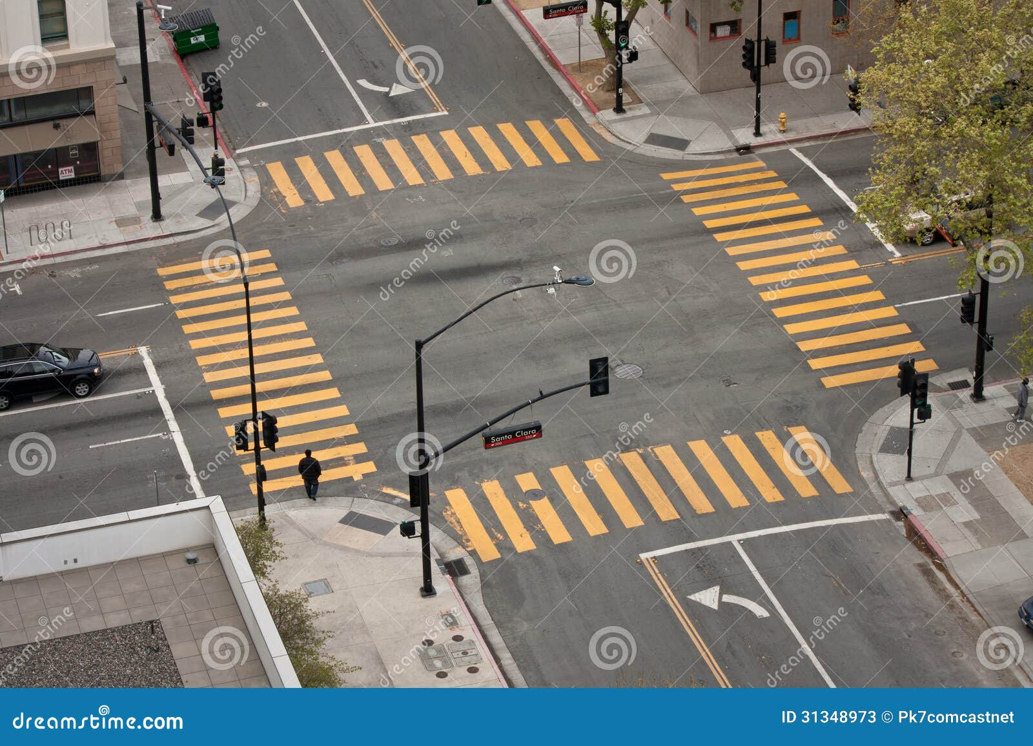
INTERSECTION
An intersection of two sets creates a new set that only contains elements that were in both original sets

Slide 16
INTERSECTION
There are two ways to program intersections
Using the & operator
Using the .intersection function
#creating an intersection using the & sign intersection_set = A & B #creating a intersection using the .intersection function intersection_set = A.intersection(B) print(intersection_set)

Slide 17

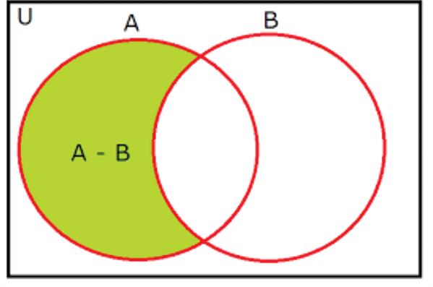
DIFFERENCE
The difference between two sets is a set containing elements in the first set, but not in the second set
Difference is the only of these operations where the order you list sets matters

Slide 18
DIFFERENCE
There are two ways to program difference:
The minus symbol
The .difference function
#creating an intersection using the - sign difference_set = A - B #creating a difference set using the .difference function, with the opposite order difference_set2 = B.difference(A) print(difference_set) print(difference_set2)

Slide 19
MINI-MID LAB
Set A: {4, 8, 15, 16, 23}
Set B: {42, 8, 16, 60, 7}
Give me the union, intersection, and difference if A is the first and B is the second

Slide 20
MINI-MID LAB
Now, create a short Python script with the following two sets:
A: Jack, Jollin, Jichael, Jole, Juis
B: Jole, Jeleste, Jichael, Jiran, Jeena, Jollin
A and B represent two users on a social media, and the sets are the people they’re following
Using set operations, print the common friends of A & B
Using set operations, identify friends of B that are not friends of A, so the platform can recommend new connections

Slide 21
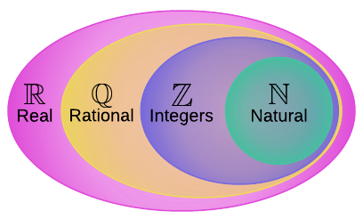
SUBSET
A subset or superset describes the relationship between two sets
Set A is considered a subset of set B if all of A’s elements are present in B
B would be considered the superset

Slide 22
SUBSET
There are 4 things we need to know about this
.issubset
A <= B
.issuperset
B >= A
#making two new sets to test subset A = {1, 4, 7} B = {1, 2, 3, 4, 5, 6, 7,} #check if A is a subset of B print(A.issubset(B)) print(A <= B) #checking for superset print(B.issuperset(A)) print(B >= A)

Slide 23
NODE CLASS
A = {1, 2, 3, 4} B = {3, 4, 5 ,6} #creating a union using the bar union_set = A | B #creating a union using the function union_set = A.union(B)

Slide 24
PROGRAMMING ASSIGNMENT
I want you to write a tester script for this program for your program assignment, along with the logic for it! Good luck!

Slide 25
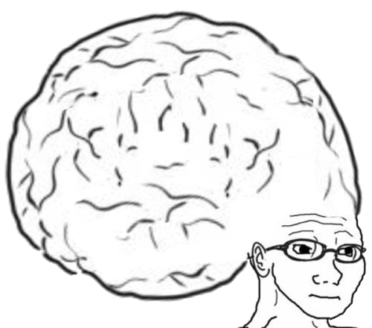
VOCABULARY TO REMEMBER
Linked List
Head
Pointer
Node

